Slide 1
NEW MODEL ALUMINUM RADIATOR
„INFINITI”
Sosnowiec 2013

Slide 2
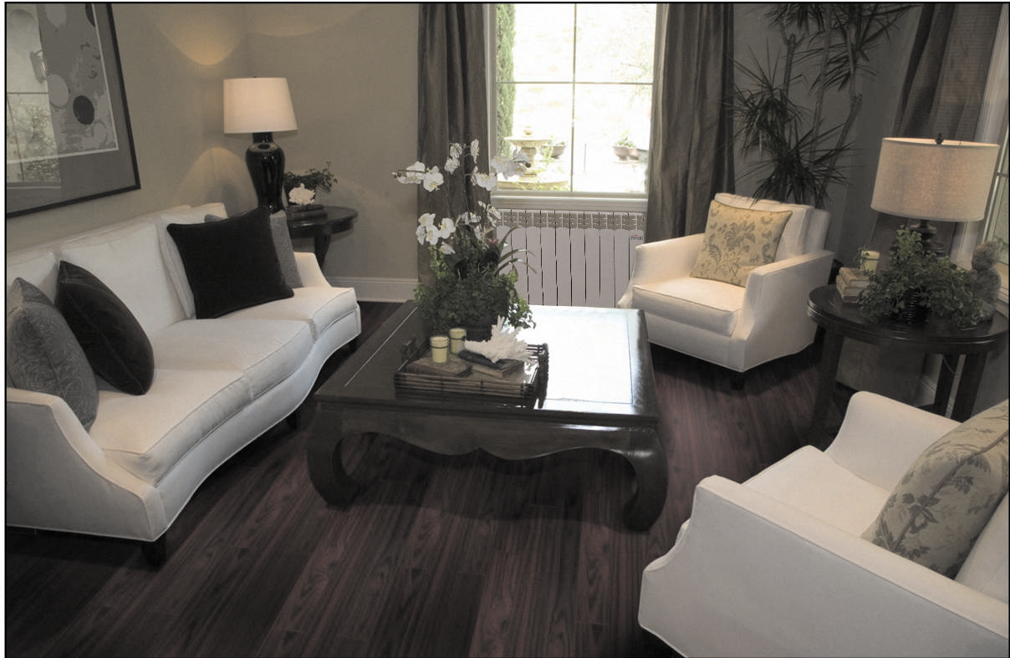
ALUMINUM RADIATOR - FERROLI
FERROLI RADIATORS ARE MADE FROM THE HIGH QUALITY OF ALUMINUM ALLOY.
DESIGN OF FERROLI RADIATORS ARE SUITABLE FOR EVERY ROOM
FERROLI EXPERIENCE GUARANTEE THE BEST PRODUCT ON THE MARKET
The Manufacturer, a FERRROLI Company, quarantees hereby that INFINITI radiator will retain good quality and useful properties for 15 years

Slide 3
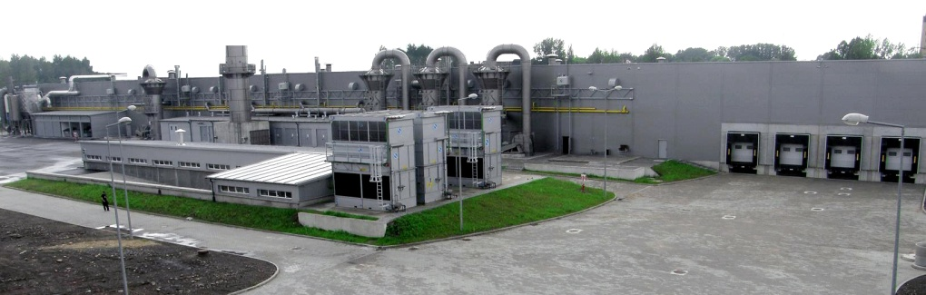
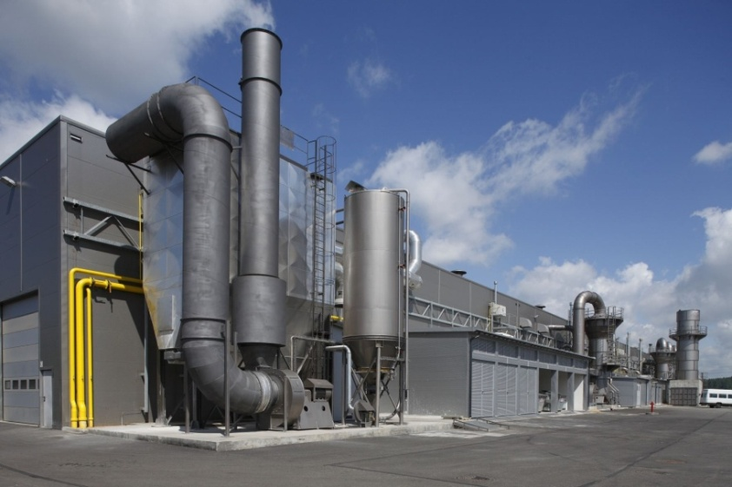
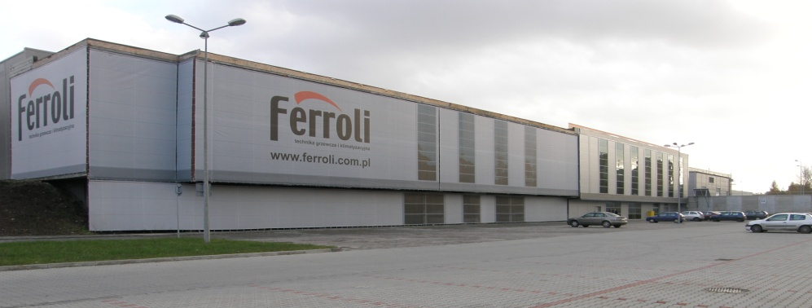
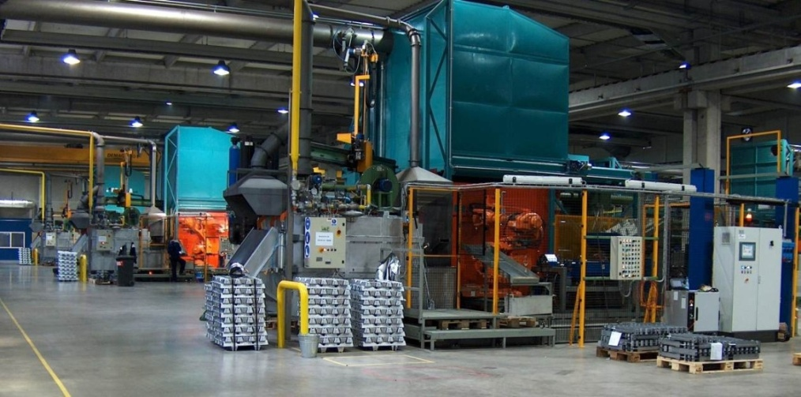
ALUMINUM RADIATORS – POLAND FACTORY
FERROLI Poland
FERROLI POLAND – FACTORY
City: SOSNOWIEC
(Economic zone Katowice)
AREA OF THE PLANT 21 000 m²

Slide 4
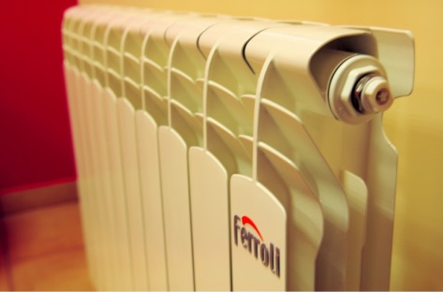
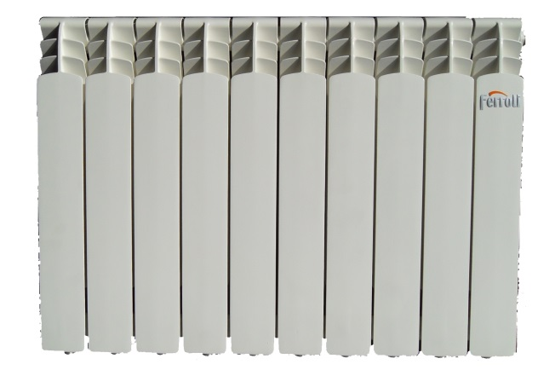
ALUMINUM RADIATORS- INFINITI
NEW MODEL - INFINITI
Warranty 15 lat
500
Distance between connectors 500 mm

Slide 5
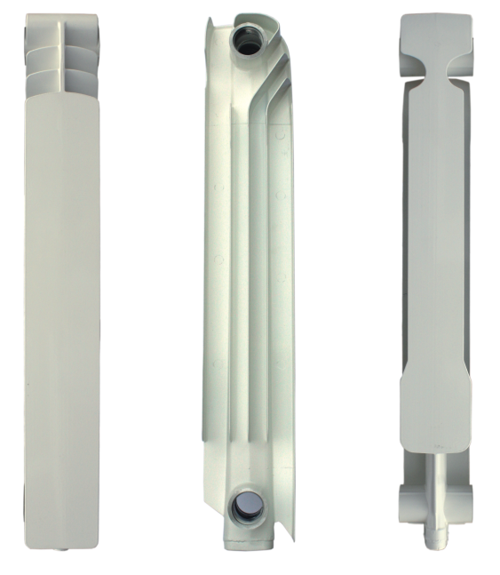
ALUMINUM RADIATORS - INFINITI
RIB DEPTH 98 mm

Slide 6
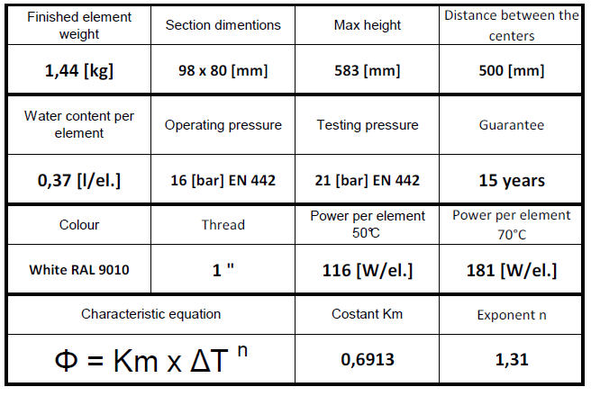
ALUMINUM RADIATOR- INFINITI

Slide 7
ALUMINUM RADIATOR- INFINITI
Every element of INFINITI radiators is painted individually

Slide 8
Place of loading – Address
Factory
Ferroli Poland Spółka z ograniczoną odpowiedzialnością
Country: Poland
City: Sosnowiec
Post code: 41-200
Street: Narutowicza 53
Every truck need to be confirmed for loading before arrival Ferroli Poland working from Monday till Friday, from 7:00 to 15:00

Slide 9
METHODS OF THE PACKING AND LOADINGS
The radiators are packed in the stretch foil and carton on pallets. This protects the radiators against damages in trasport and storage.
Carton of INFINITI

Slide 10
METHODS OF THE PACKING AND LOADINGS
One standardpallet contains:
44 radiators (440 elements.)
 |  | Width
 | INFINITI |  | INFINITI
 | INFINITI |  | INFINITI
 | INFINITI |  | INFINITI
 | INFINITI |  | INFINITI
 | INFINITI |  | INFINITI
 | INFINITI |  | INFINITI
 | INFINITI |  | INFINITI
 | INFINITI |  | INFINITI
 | INFINITI |  | INFINITI
Height | INFINITI |  | INFINITI
 | INFINITI |  | INFINITI
 | INFINITI |  | INFINITI
 | INFINITI |  | INFINITI
 | INFINITI |  | INFINITI
 | INFINITI |  | INFINITI
 | INFINITI |  | INFINITI
 | INFINITI |  | INFINITI
 | INFINITI |  | INFINITI
 | INFINITI |  | INFINITI
 | INFINITI |  | INFINITI
 | INFINITI |  | INFINITI
 | INFINITI |  | INFINITI |  | Depth
Pallet dimensions:
2,45 x 1,23 x 0,82 m (height x width x depth)
1 Pallet – 680 KG ( weight gross )

Slide 11
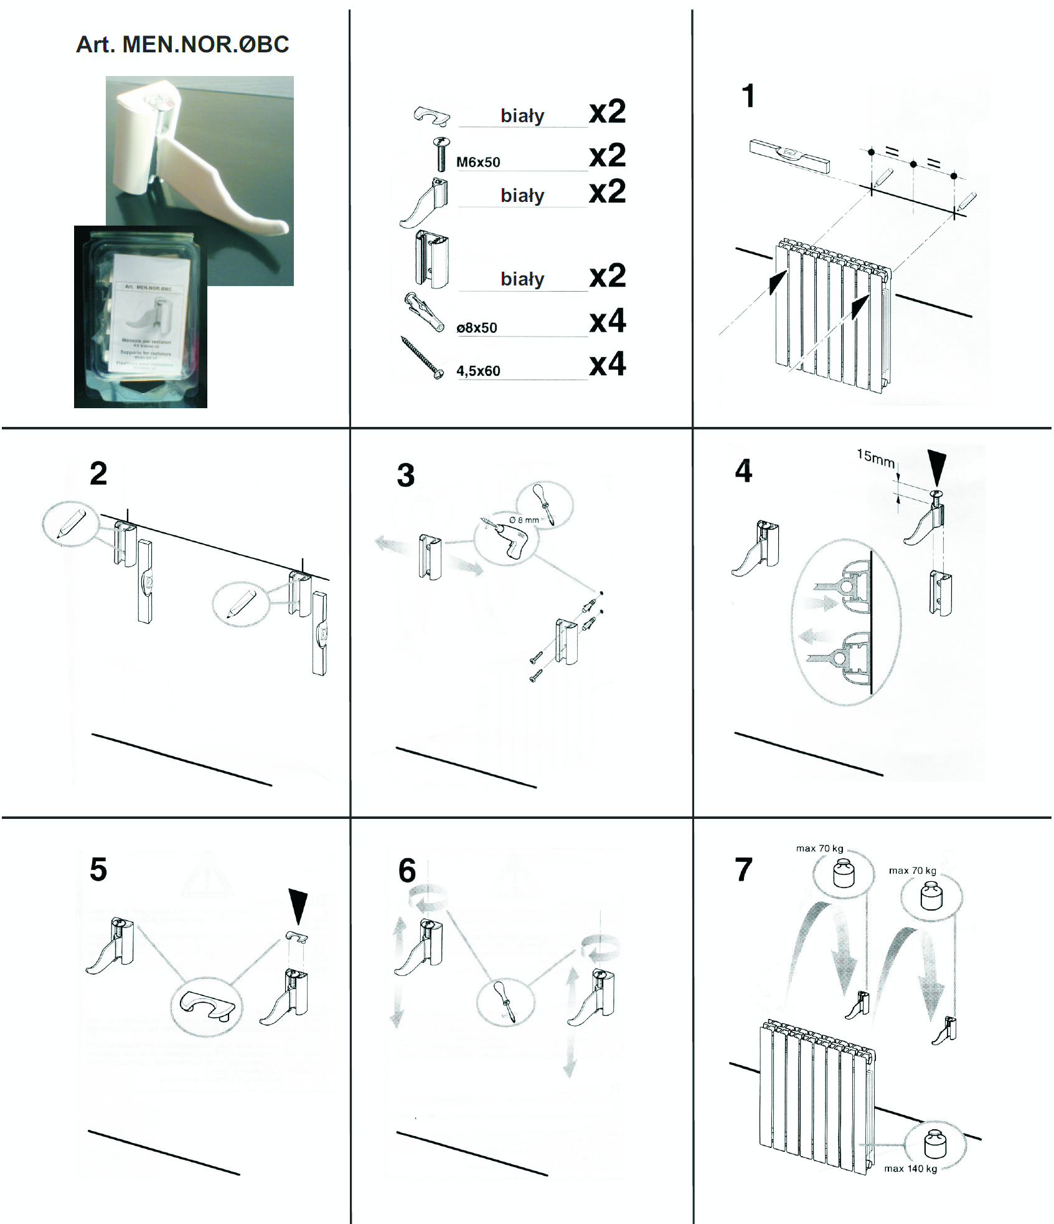
Accessories: Wall brackets
Brackets
easy to fit up
esthetic – white colour
easy leveling
After fixing to the wall we can adjust:
- 15 mm in vertical
5 mm in horizontal
(distance from the wall).

Slide 12
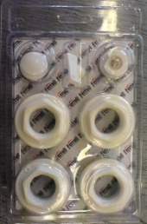
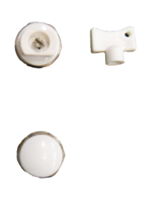
Accessories: radiator plugs reduction1”x1/2”
Radiator plugs reduction 1"x1/2" with the accessories
The pack contains:
radiator plug reduction left 1"x1/2" 2 pieces
teflon seal of plug 2 pieces
radiator plug reduction right1"x1/2" 2 pieces
teflon seal of plug 2 pieces
- Manul radiator air vent 1/2" 1 piece
- Key for the air vent 1 piece
- Stopping plug 1/2" 1 piece

Slide 13
Ferroli

Slide 14
Half a century as a specialist in HVAC

